Slide 1
Strategic Leadership
607MAN 303MAN
Power and Influence in Leadership
Week 2 S6

Slide 2
Session Outcomes
Evaluate and apply conceptual and practical approaches to strategic leadership in a range of different organisational settings.
Analyse contemporary research on the role of leadership in managing change.
Critically assess the relevance of leadership styles to key sector changes including globalisation, internationalisation, strategy, technological innovation and organisation development.
Identify and critically reflect on leadership capabilities and strategies of key Business leaders across a range of sectors.
Evaluate an incident of strategic organisational change by exploring the role of leadership and the measurement and management of Key Performance Indicators (KPI’s).
Critically explore the ethical relationships between leaders and followers in relation to decision making, corporate governance and policy practices in organisations.

Slide 3

What we’re going to cover today…
(1)
Stakeholders
(2)
Power and influence

Slide 4
Stakeholders

Slide 5
Who are the stakeholders?
Stakeholders are those individuals or groups that depend on an organisation to fulfil their own goals and on whom, in turn, the organisation depends.

Slide 6
Types of stakeholder
Stakeholders can be divided into internal stakeholders (e.g. managers and employees) and external stakeholders.
External stakeholders are of 4 types:
Economic (e.g. suppliers, shareholders, banks)
Social/political (e.g. government agencies)
Technological (e.g. standards agencies)
Community (e.g. local residents)

Slide 7
Stakeholder Mapping
Stakeholder mapping identifies stakeholder power and attention in order to understand political priorities.
The power and interest of stakeholders depend on the particular issue being considered – different issues require different maps.

Slide 8
Conflicts of stakeholder interests and expectations
Pursuit of short-term profits may suit shareholders and managerial bonuses but come at the expense of investment in long-term projects.
Family business owners may want business growth, but also fear the loss of family control if they need to appoint professional managers to cope with larger-scale operations.

Slide 9
Conflicts of stakeholder interests and expectations
Investing in growth strategies may require additional funding through share issue or loans, but thereby risk financial security and independence.
Going public on the stock market may raise funds, but require unwelcome degrees of openness and accountability from management.
Expanding into mass markets may require a reduction in quality standards.

Slide 10
Conflicts of stakeholder interests and expectations
In public services, excellence in specialised services might divert resources from standard services used by the majority (e.g. heart transplants come at the cost of preventative dentistry).
In large multinational organisations, conflict can result because of a local division's responsibilities simultaneously to the company head-office and to its host country.

Slide 11
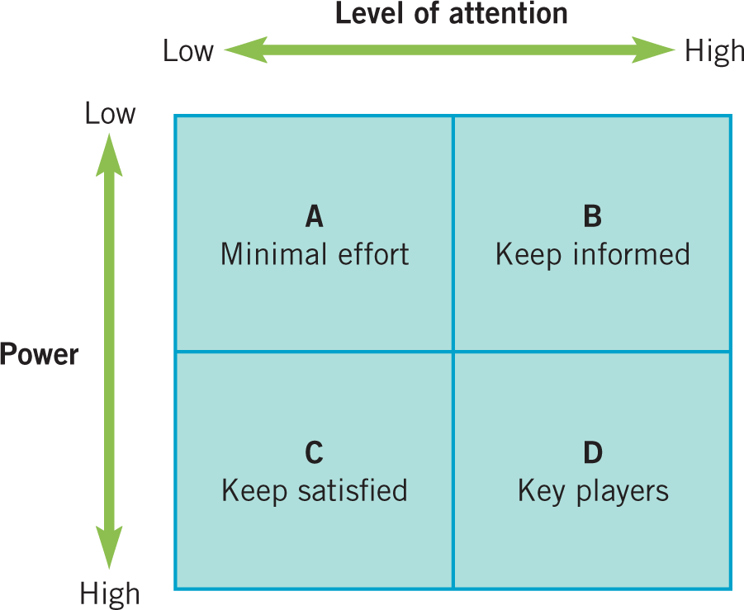
Stakeholder Mapping: the power/attention matrix.
Source: Adapted from Newcombe, R. ‘From client to project stakeholders: a stakeholder mapping approach’’, Construction Management and Economics vol. 21, no. 8 (2003): 841-8.
Notes:
Figure 5.3 Stakeholder mapping: the power/attention matrix

Slide 12
Stakeholder Mapping Issues
Determining purpose and strategy – whose expectations need to be prioritised?
Who are the key blockers and facilitators of strategy?
Can the level of interest or power of key stakeholders be maintained?
Will stakeholder positions shift according to the issue/strategy being considered?

Slide 13
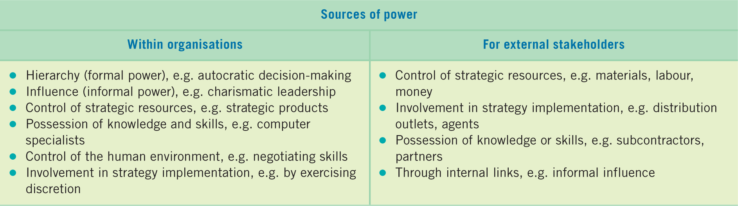
Power and Sources of Power
Power is the ability of individuals or groups to persuade, induce or coerce others into following certain courses of action.

Slide 14
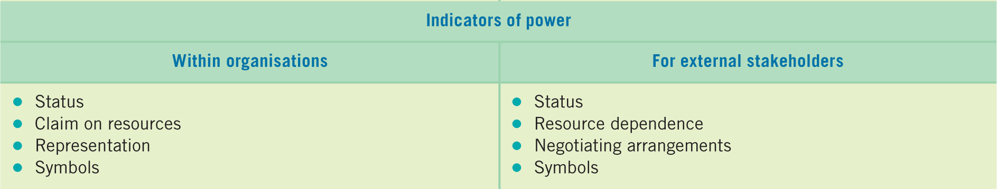
Indicators of Power

Slide 15
Power and Influence

Slide 16
Power and Influence
Power
The ability of one person or department in an organization to influence other people to bring about desired outcomes
Influence
The effect a person’s actions have on the attitudes, values, beliefs, or actions of others.
Authority
The right to try to change or direct others; notion of legitimacy

Slide 17
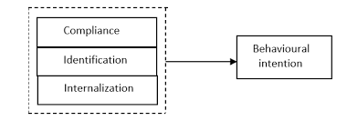
Kelman’s (1958) Theory of Influence
Three reasons why people give in to others’ attempts to influence them:
Compliance: behavior results in rewards or avoidance of punishment
Identification: the desire to maintain a personally satisfying relationship
Internalization: the belief that the behavior is consistent with ones own values

Slide 18
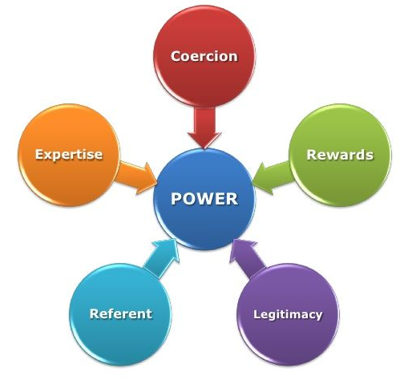
French & Raven’s (1968) Five Bases of Power
Five “sources” from which power is derived:
Reward power
Coercive power
Legitimate power
Referent power
Expert power

Slide 19
Reward Power
Authority to bestow rewards on other people
Appointed leaders may have access to rewards such as pay increases, promotions, physical resources
Influences subordinate’s behavior

Slide 20
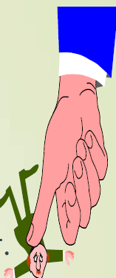
Coercive Power
Authority to punish or recommend punishment
Opposite of reward power
Right to fire, demote, criticize, reprimand or withdraw pay raises

Slide 21

Legitimate Power
Authority granted from a formal positions in an organization.
Rights, responsibilities and prerogatives accrue to anyone holding a formal leadership position
Set goals, make decisions and direct activities
The socialization and culture of employees will influence
to some degree how much power a manger has due to
his or her position.

Slide 22

Referent Power
Comes from personality characteristics that command identification, respect and admirations so that others want to emulate the person
Dependent on personal characteristics rather than title
Strong identification with leader

Slide 23
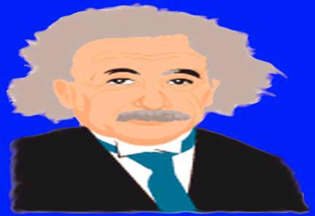
Expert Power
Results from special knowledge or skill
Followers go along with recommendations because of his/her superior knowledge
Usually gained from experience

Slide 24

Where does power come from?
Position Power
A written, spoken, or implied contract wherein people accept either a superior or subordinate role and see the use of coercive as well as noncoercive behavior as an acceptable way of achieving desirable results.

Slide 25
Informal vs. Formal Power
Informal Power bases (expert & referent)
reside in characteristics of the individual
important for satisfaction & performance
Formal power bases (legitimate, reward, coercive)
based upon position in social organization
have strong impact on immediate behavior

Slide 26

Gender and Power
Research has found that women view power differently than men do.
For some women, power may be viewed as dominance vs. submission, associated with personal qualities, not accomplishment
and
depends on personal and physical attribute, not skills.

Slide 27

Discuss It
Do you think that there are gender differences in how people view power?
Who would you think is better in using their authority - men or women?
Who would you prefer to be your boss?

Slide 28
What we’ve covered today…
(1)
Stakeholders
(2)
Power and influence

Slide 29

Traffic Light it
Where is your learning at?
Red = I have misunderstood some of the topics. (write down 2 questions that you need help with)
Amber = I have understood most of the topics so far (write down 1 question and 1 key theme you have understood)
Green = I have understood the topics so far (write down 2 key themes from the lesson to show your understanding)

Slide 30

Reading list
Essential Reading
Lynch, R., (2021) Strategic Management. 9th edn. London: Pearson Education
Yukl, G. (2020), Leadership in Organizations: Global Edition. 9th edn. Los Angeles: SAGE
Recommended Reading
Robbins, S.P., De Cenzo, D.A., Coulter, M. (2020) Fundamentals of Management: Management Myths Debunked! Global Edition. 11th edn. Harlow: Pearson
Johnson, G., Whittington R., Scholes K. (2020) Exploring Strategy: Texts and Cases. 12th edn. Harlow: Pearson.

